Slide 1
Randomized Algorithms CS648
Lecture 23
Hashing – II
Probabilistic Method - II

Slide 2
Probabilistic methods - II

Slide 3
problem 2 How many Acute Triangles ?

Slide 4
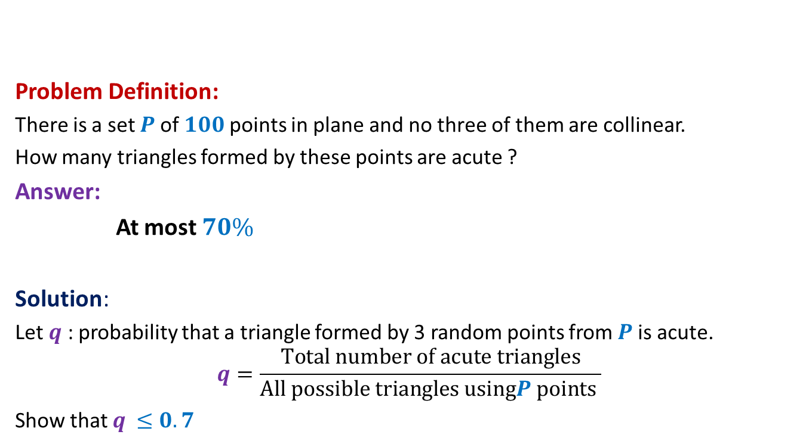
How many acute triangles
Problem Definition:
There is a set $P$of $100$points in plane and no three of them are collinear.
How many triangles formed by these points are acute ?
Answer:
At most $70\%$
Solution:
Let $q$ : probability that a triangle formed by 3 random points from $P$is acute.
$$q=\frac{Total number of acute triangles}{All possible triangles usingP points }$$
Show that $q$ $≤0.7$

Slide 5


$4$ points ➔ $5$ points
Lemma1: A triangle formed by selecting 3 points randomly uniformly
from 4 points is acute triangle with probability at most $0.75$.
Lemma2: A triangle formed by selecting 3 points randomly uniformly
from 5 points is acute triangle with probability at most $0.7$.
Extension to 100 points ?
☹

Slide 6

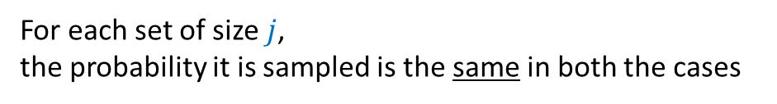



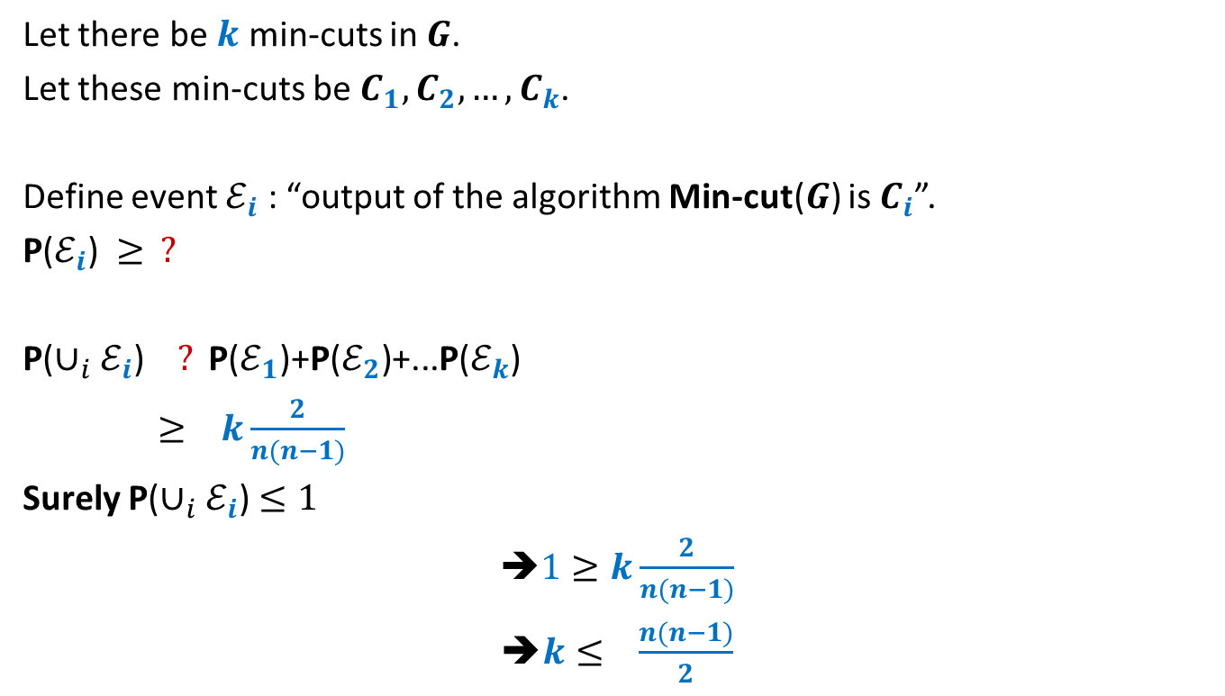






Two stage sampling
How to show this formally ?
$$j≤k≤n$$
$$R_{2}$$
$$j$$
?
Same probability distribution
$$R_{1}$$
$$k$$
$$R$$
$$j$$
$$S$$
$$n$$
$$S$$
$$n$$
Show that:
For each set of size $j$,
the probability it is sampled is the same in both the cases

Slide 7




Two stage sampling
$$j≤k≤n$$
$$R_{2}$$
$$j$$
$$3$$
?
Same probability distribution
$$5$$
$$R_{1}$$
$$k$$
$$3$$
$$R$$
$$j$$
$$S$$
$$n$$
$$S$$
$$n$$

Slide 8

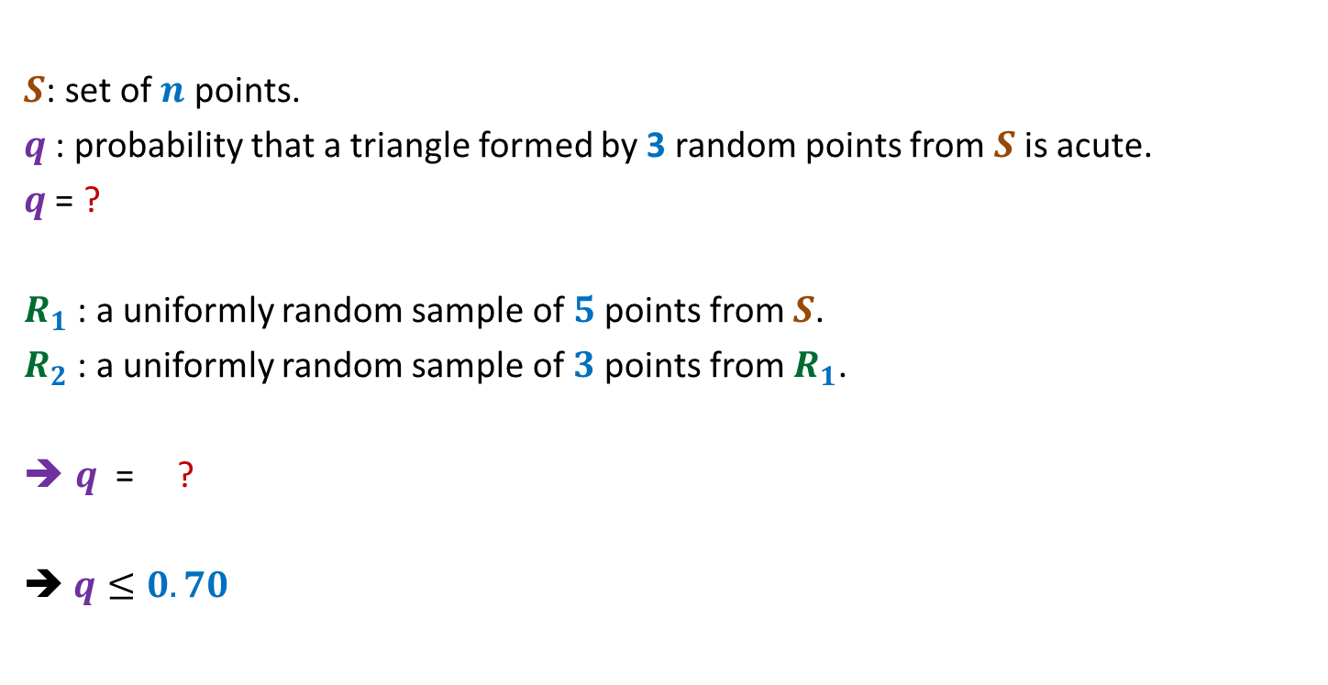


Number of acute triangles
$S$: set of $n$ points.
$q$ : probability that a triangle formed by 3 random points from $S$is acute.
$q$ = ?
$R_{1}$ : a uniformly random sample of $5$points from $S$.
$R_{2}$ : a uniformly random sample of $3$points from $R_{1}$.
$q$ = ?
➔ $q≤0.70$
P(a random triangle from $S$ is acute)
= P(a random triangle from $R_{2}$ is acute)
$$≤0.70$$

Slide 9
problem 3 Large CUT in a graph

Slide 10
Undirected graph

Slide 11

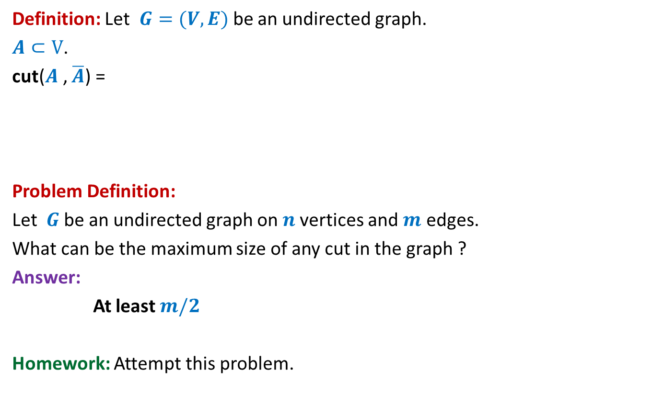
Large cut in a graph
Definition: Let $G=(V,E)$be an undirected graph.
$A⊂V$.
cut($A$, $\overline{A}$) =
Problem Definition:
Let $G$be an undirected graph on $n$vertices and $m$ edges.
What can be the maximum size of any cut in the graph ?
Answer:
At least $m/2$
Homework: Attempt this problem.
{ $\left(u,v\right)∈E$) : $u∈A$, $v∈$ $\overline{A}$ or $u∈\overline{A}$, $v∈$ $A$}

Slide 12
Recap of Last Lecture
Hashing with worst case optimal guarantee

Slide 13
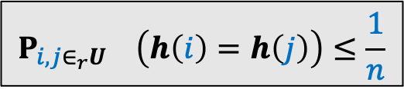


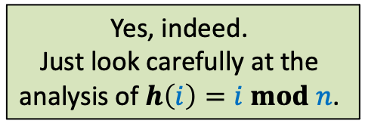
Why does hashing work so well in Practice ?
$h\left(i\right)=i mod n$ works so well because
for a uniformly random subset of $U$,
the expected number of collision at an index of $T$ is O(1).
Homework of the last class
Show that every hash function $h$ will also do well in practice provided it
satisfies the following inequality.
Can there be other hash functions as well that will do well in practice ?
Yes, indeed.
Just look carefully at the
analysis of $h\left(i\right)=i mod n$.
$$P_{i,j∈_{r}U} \left(h\left(i\right)=h\left(j\right)\right)≤\frac{1}{n}$$
“How can we achieve worst case O(1) search time for a given set $S$.”
But it is easy to fool each such hash function
such that it achieves O(s) search time.

Slide 14
Static Hashing worst Case O(1) search time
Michael Fredman, Janos Komlos, Endre Szemeredy.
Storing a Sparse Table with O(1) Worst Case Access Time.
Journal of the ACM (Volume 31, Issue 3), 1984.
Key idea : universal hash family

Slide 15


Universal Hash Family
Definition: A collection $H$of hash-functions is said to be c-universal
if there exists a constant $c$such that for any $i,j∈U$,
$P_{} \left(h\left(i\right)=h\left(j\right)\right)≤\frac{c}{n}$
$$h∈_{r}H$$

Slide 16
Why such a definition for Universal Hash family ?

Slide 17
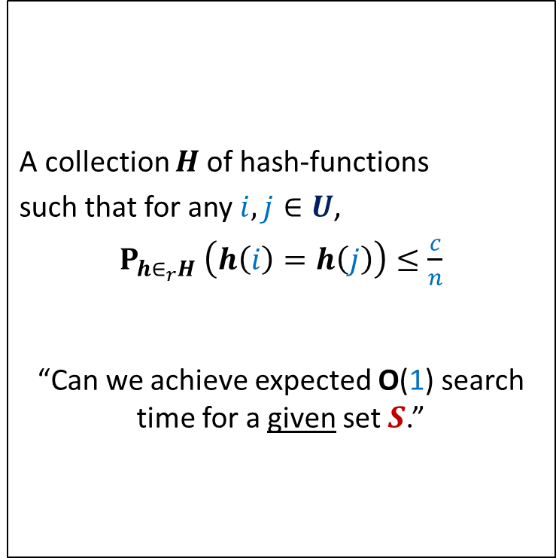
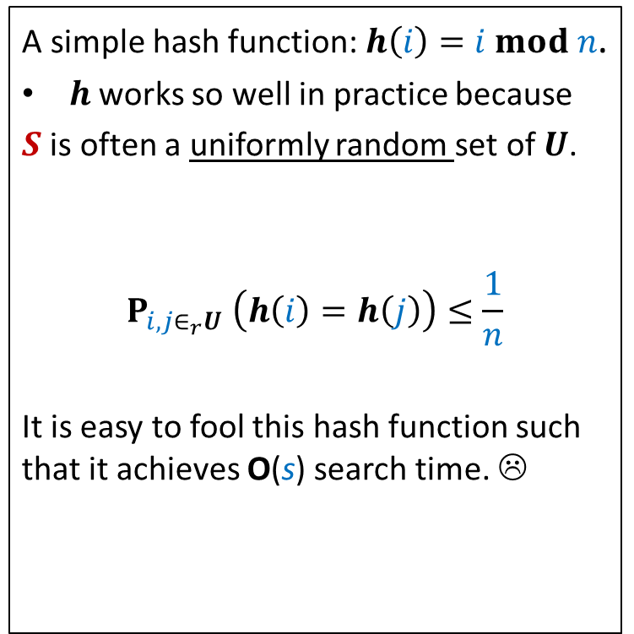
The INSPIRATION
Why does hashing work so well in Practice ?
A simple hash function: $h\left(i\right)=i mod n$.
$h$works so well in practice because
$S$ is often a uniformly random set of $U$.
$$P_{i,j∈_{r}U} \left(h\left(i\right)=h\left(j\right)\right)≤\frac{1}{n}$$
It is easy to fool this hash function such that it achieves O(s) search time. ☹
A collection $H$of hash-functions
such that for any $i,j∈U$,
$P_{h∈_{r}H} \left(h\left(i\right)=h\left(j\right)\right)≤\frac{c}{n}$
“Can we achieve expected O(1) search time for a given set $S$.”
Universal hash family
similar question while
Quick Sort ➔ Randomized Quick Sort

Slide 18
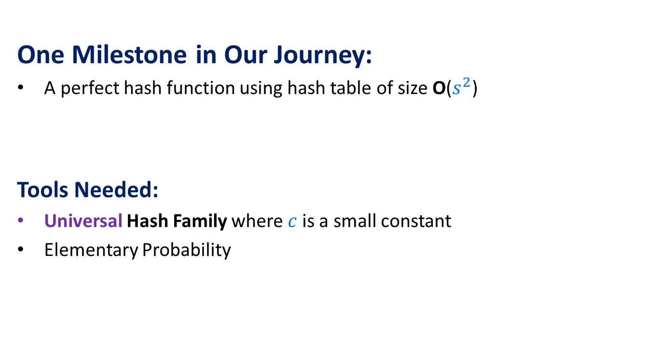
The Journey
One Milestone in Our Journey:
A perfect hash function using hash table of size O($s^{2}$)
Tools Needed:
Universal Hash Family where $c$is a small constant
Elementary Probability

Slide 19
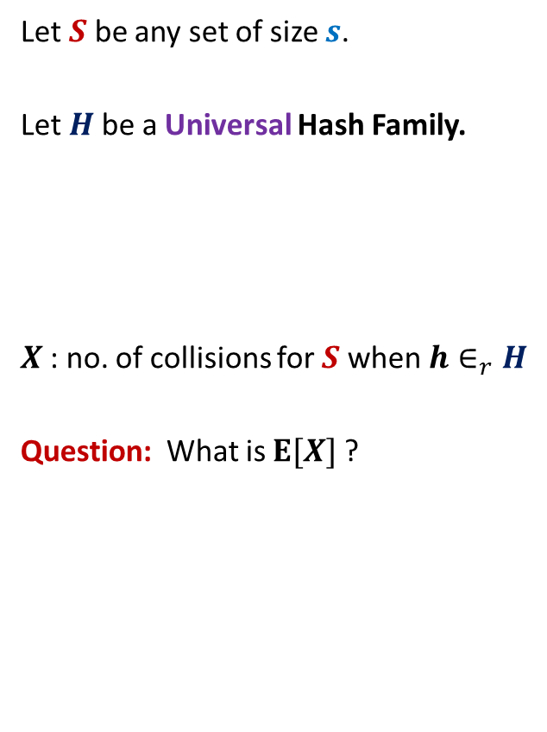

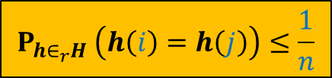
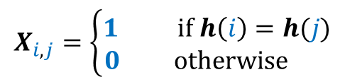
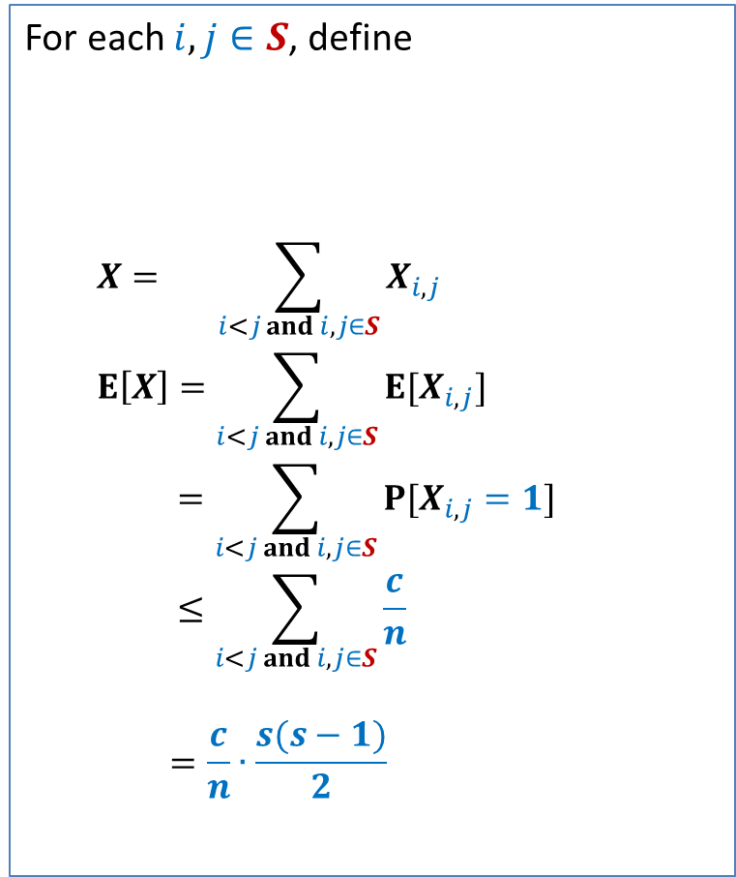
Perfect hashing using O($s^{2}$) space
Let $S$ be any set of size $s$.
Let $H$be a Universal Hash Family.
$X$: no. of collisions for $S$ when $h∈_{r}H$
Question: What is $E[X]$?
For each $i,j∈S$, define
$$X= \sum_{i<j and i,j∈S}{X_{i,j}}$$
$$E\left[X\right]=\sum_{i<j and i,j∈S}{E[X_{i,j}]}$$
$$=\sum_{i<j and i,j∈S}{P[X_{i,j}=1]}$$
$$≤\sum_{i<j and i,j∈S}{\frac{c}{n}}$$
$$=\frac{c}{n}∙\frac{s(s−1)}{2}$$
$$X_{i,j}=\left\{\begin{aligned}1 if h\left(i\right)=h(j) \\ 0 otherwise \end{aligned}\right.$$
$$P_{h∈_{r}H} \left(h\left(i\right)=h\left(j\right)\right)≤\frac{1}{n}$$

Slide 20
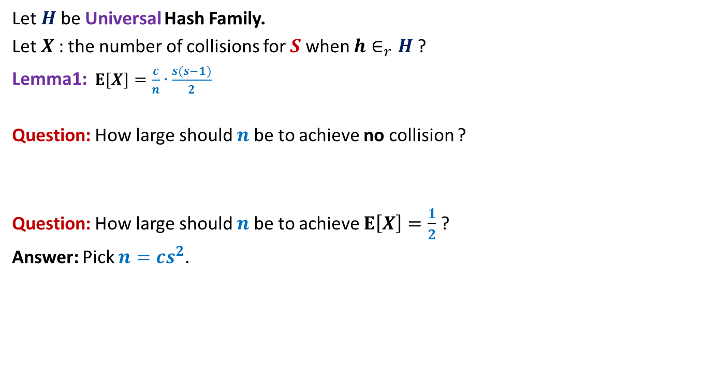
Perfect hashing using O($s^{2}$) space
Let $H$be Universal Hash Family.
Let $X$: the number of collisions for $S$ when $h∈_{r}H$?
Lemma1:$E[X]=\frac{c}{n}∙\frac{s(s−1)}{2}$
Question: How large should $n$be to achieve no collision ?
Question: How large should $n$be to achieve $E\left[X\right]=\frac{1}{2}$ ?
Answer: Pick $n=cs^{2}$.

Slide 21
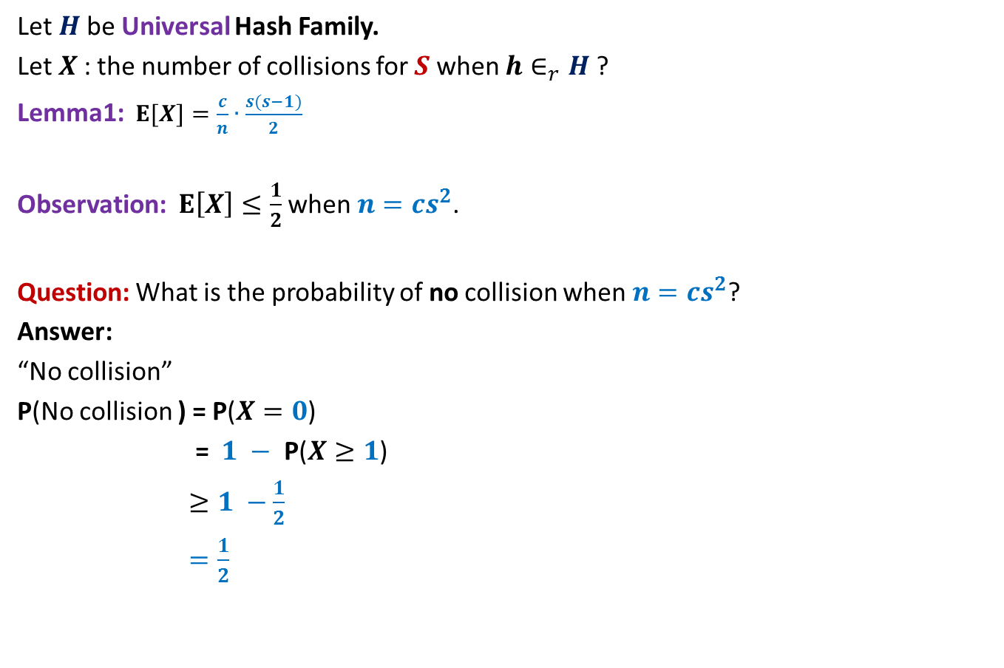

Perfect hashing using O($s^{2}$) space
Let $H$be Universal Hash Family.
Let $X$: the number of collisions for $S$ when $h∈_{r}H$?
Lemma1:$E[X]=\frac{c}{n}∙\frac{s(s−1)}{2}$
Observation: $E\left[X\right]≤\frac{1}{2}$ when $n=cs^{2}$.
Question: What is the probability of no collision when $n=cs^{2}$?
Answer:
“No collision”
P(No collision ) = P($X=0$)
= $1 −$ P($X≥1$)
$≥1 −\frac{1}{2}$
$=\frac{1}{2}$
⬄ “$X=0$”
Use Markov’s Inequality to bound it.

Slide 22
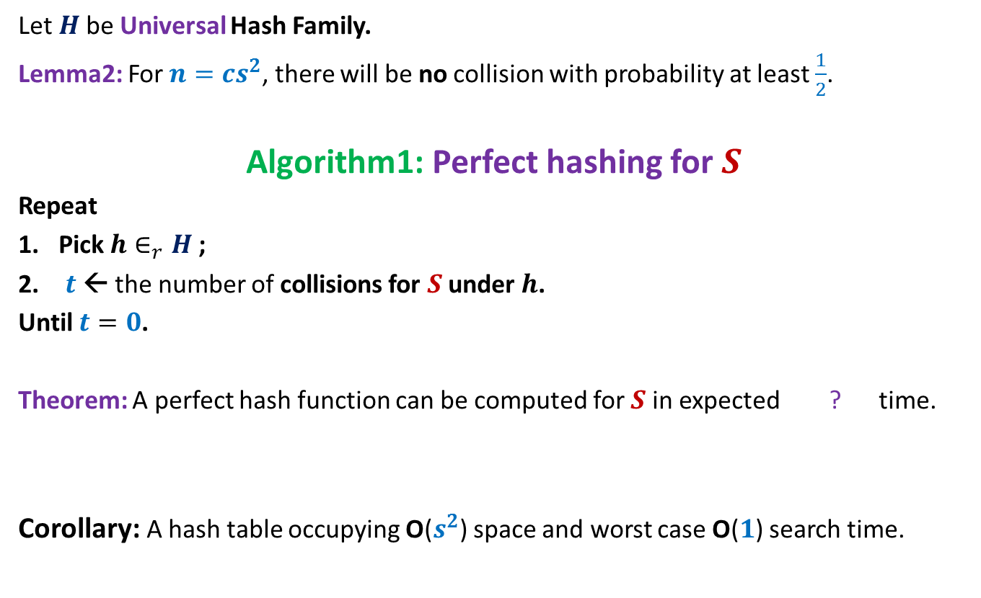

Perfect hashing using O($s^{2}$) space
Let $H$be Universal Hash Family.
Lemma2: For $n=cs^{2}$, there will be no collision with probability at least $\frac{1}{2}$.
Algorithm1: Perfect hashing for $S$
Repeat
Pick $h∈_{r}H$;
$t$← the number of collisions for $S$ under $h$.
Until $t=0$.
Theorem: A perfect hash function can be computed for $S$in expected ? time.
Corollary: A hash table occupying O($s^{2}$) space and worst case O($1$) search time.
O($s^{2}$)

Slide 23
Hashing with Optimal space And Worst case O(1) search time

Slide 24
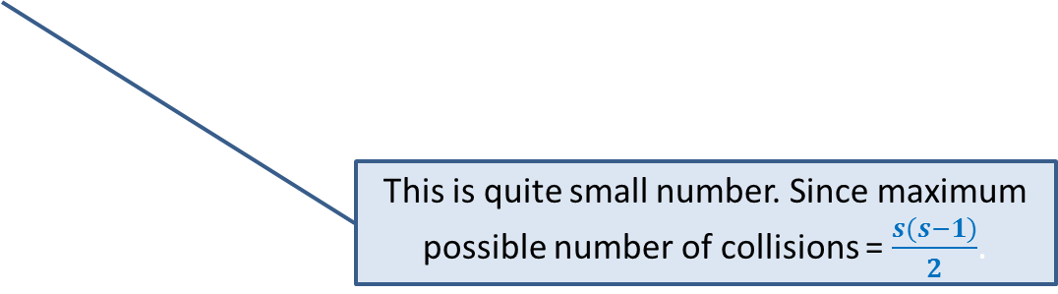

Optimal space hashing with worst case O(1) search time
$H$be Universal Hash Family.
$X$: no. of collisions for $S$ when $h∈_{r}H$?
Lemma1:$E[X]=\frac{c}{n}∙\frac{s(s−1)}{2}$.
Question: What is $E[X$] when $n$ = $s$ ?
Answer: $c\frac{(s−1)}{2}$.
Since we are aiming for linear space, let us see how many collisions will there be for linear space ?
This is quite small number. Since maximum possible number of collisions = $\frac{s(s−1)}{2}$.

Slide 25
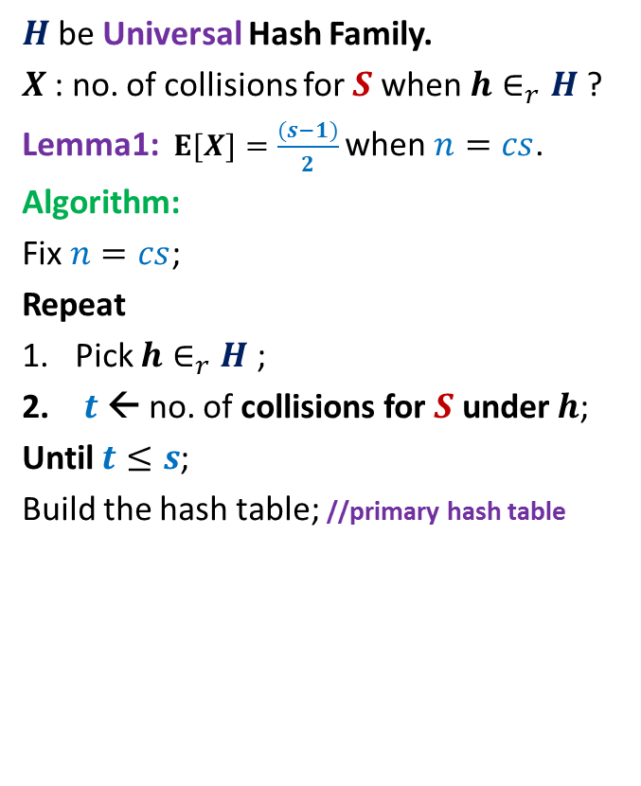

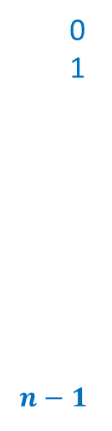
Optimal space hashing with worst case O(1) search time
$H$be Universal Hash Family.
$X$: no. of collisions for $S$ when $h∈_{r}H$?
Lemma1:$E[X]=\frac{(s−1)}{2}$ when $n=cs$.
Algorithm:
Fix $n=cs$;
Repeat
Pick $h∈_{r}H$;
$t$← no. of collisions for $S$ under $h$;
Until $t≤s$;
Build the hash table; //primary hash table
$$T$$
0
1
$$n−1$$

Slide 26
Optimal space hashing with worst case O(1) search time
$H$be Universal Hash Family.
$X$: no. of collisions for $S$ when $h∈_{r}H$?
Lemma1:$E[X]=\frac{(s−1)}{2}$ when $n=cs$.
Algorithm:
Fix $n=cs$;
Repeat
Pick $h∈_{r}H$;
$t$← no. of collisions for $S$ under $h$;
Until $t≤s$;
Build the hash table; //primary hash table
$$T$$
0
1
$$n−1$$

Slide 27
Optimal space hashing with worst case O(1) search time
$H$be Universal Hash Family.
$X$: no. of collisions for $S$ when $h∈_{r}H$?
Lemma1:$E[X]=\frac{(s−1)}{2}$ when $n=cs$.
Algorithm:
Fix $n=cs$;
Repeat
Pick $h∈_{r}H$;
$t$← no. of collisions for $S$ under $h$;
Until $t≤s$;
Build the hash table; //primary hash table
$$T$$
0
1
$$n−1$$

Slide 28
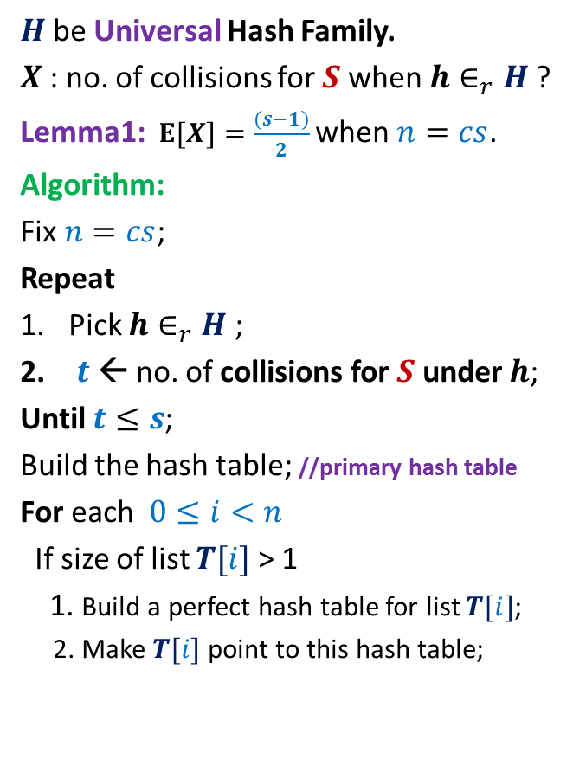
Optimal space hashing with worst case O(1) search time
$H$be Universal Hash Family.
$X$: no. of collisions for $S$ when $h∈_{r}H$?
Lemma1:$E[X]=\frac{(s−1)}{2}$ when $n=cs$.
Algorithm:
Fix $n=cs$;
Repeat
Pick $h∈_{r}H$;
$t$← no. of collisions for $S$ under $h$;
Until $t≤s$;
Build the hash table; //primary hash table
For each $0≤i<n$
If size of list $T[i]$ > 1
1. Build a perfect hash table for list $T[i]$;
2. Make $T[i]$ point to this hash table;
$$T$$
0
1
$$n−1$$

Slide 29
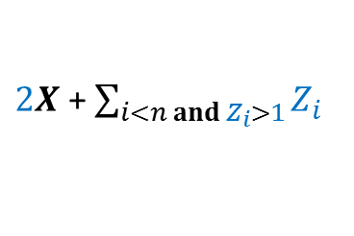


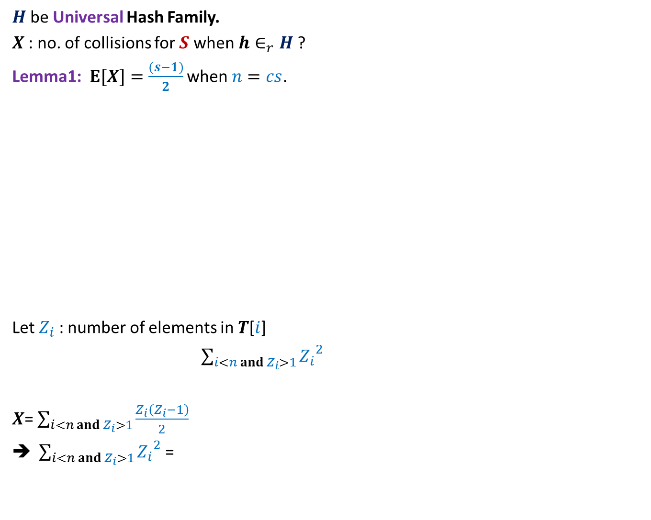
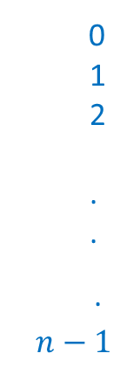
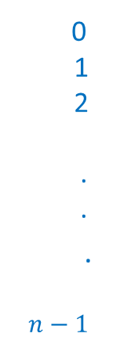

$H$be Universal Hash Family.
$X$: no. of collisions for $S$ when $h∈_{r}H$?
Lemma1:$E[X]=\frac{(s−1)}{2}$ when $n=cs$.
Let $Z_{i}$ : number of elements in $T$[$i$]
$\sum_{i<n and{ Z}_{i}>1}{{Z_{i}}^{2}}$
$X$= $\sum_{i<n and Z_{i}>1}{\frac{Z_{i}\left(Z_{i}−1\right)}{2}}$
$\sum_{i<n and Z_{i}>1}{{Z_{i}}^{2}}$ =
$$T$$
$$T$$
0
1
2
.
.
.
$$n−1$$
0
1
2
.
.
.
$$n−1$$
Extra Space required :
Is there any relation between $X$and $Z_{i}$’s ?
$2X$ + $\sum_{i<n and{ Z}_{i}>1}{Z_{i}}$

Slide 30
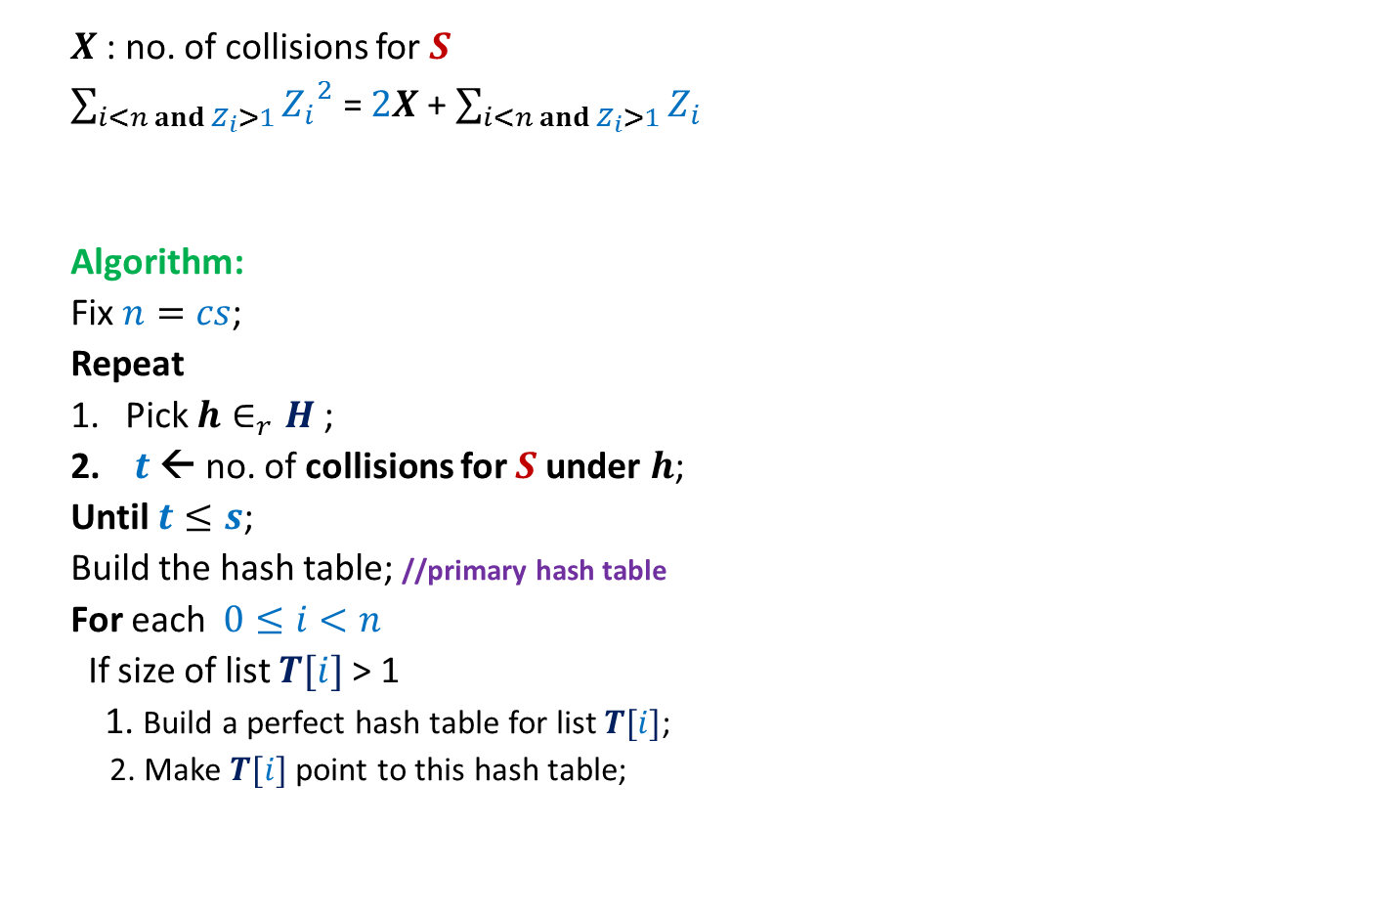

Optimal space hashing with worst case O(1) search time
$X$: no. of collisions for $S$
$\sum_{i<n and Z_{i}>1}{{Z_{i}}^{2}}$ = $2X$ + $\sum_{i<n and{ Z}_{i}>1}{Z_{i}}$
Algorithm:
Fix $n=cs$;
Repeat
Pick $h∈_{r}H$;
$t$← no. of collisions for $S$ under $h$;
Until $t≤s$;
Build the hash table; //primary hash table
For each $0≤i<n$
If size of list $T[i]$ > 1
1. Build a perfect hash table for list $T[i]$;
2. Make $T[i]$ point to this hash table;
$$≤3s$$
$$T$$
0
1
2
.
.
.
$$n−1$$

Slide 31
A simple and Compact Universal Hash family

Slide 32
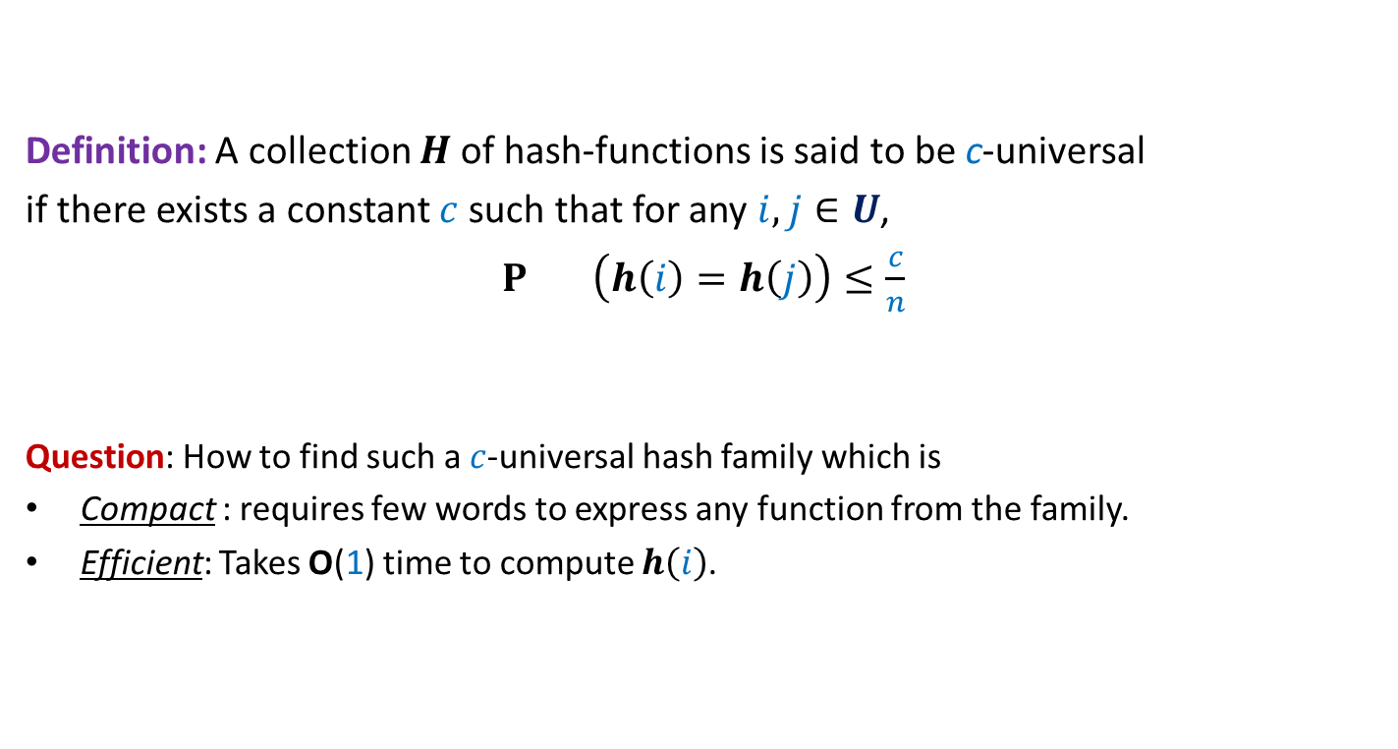
Universal Hash Family
Definition: A collection $H$of hash-functions is said to be c-universal
if there exists a constant $c$such that for any $i,j∈U$,
$P_{} \left(h\left(i\right)=h\left(j\right)\right)≤\frac{c}{n}$
Question: How to find such a $c$-universal hash family which is
Compact : requires few words to express any function from the family.
Efficient: Takes O(1) time to compute $h\left(i\right)$.
$$h∈_{r}H$$

Slide 33
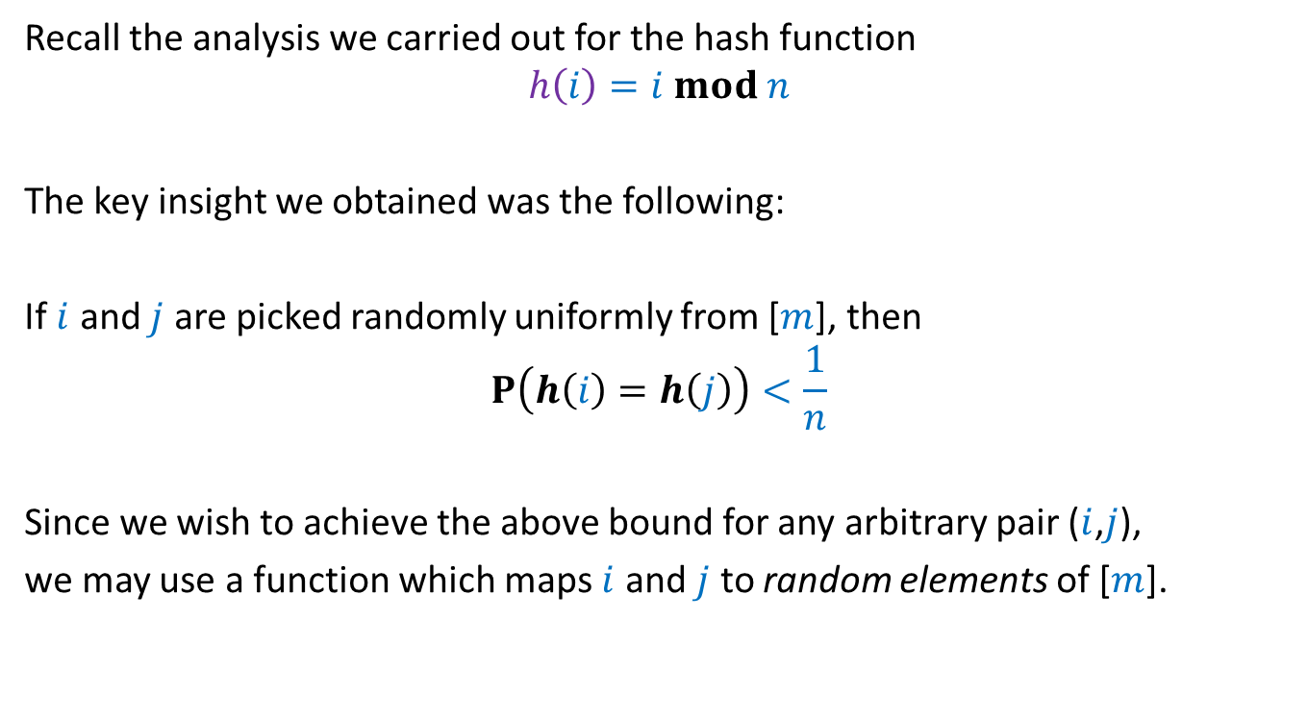
The intuition
Recall the analysis we carried out for the hash function
$$h\left(i\right)=i mod n$$
The key insight we obtained was the following:
If $i$ and $j$ are picked randomly uniformly from [$m$], then
$$P\left(h\left(i\right)=h\left(j\right)\right)<\frac{1}{n}$$
Since we wish to achieve the above bound for any arbitrary pair ($i$,$j$),
we may use a function which maps $i$ and $j$ to random elements of [$m$].

Slide 34
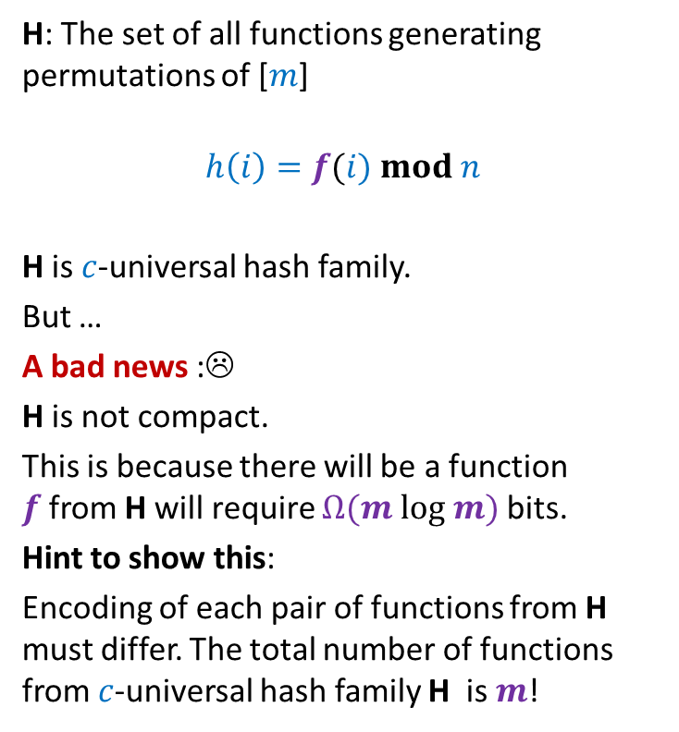



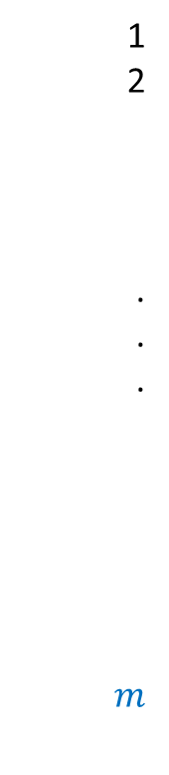
A random permutation of [$1..m$]
1
2
.
.
.
$$m$$
H: The set of all functions generating permutations of [$m$]
$$h\left(i\right)=f(i) mod n$$
H is $c$-universal hash family.
But …
A bad news :☹
H is not compact.
This is because there will be a function $f$from H will require $Ω(m log m)$bits.
Hint to show this:
Encoding of each pair of functions from H must differ. The total number of functions from $c$-universal hash family H is $m$!
$$f$$
$$i$$
$$j$$

Slide 35
Homework
Make sincere attempts to design a compact and efficient universal hash family.
In the next lecture, we shall design such a family using …
… just `mod’ function ☺

